Slide 1
Zomato Orders & Restaurant Analysis
By Nahid Bilal Sayyed

Slide 2
Introduction:
In this project, we analysed how many restaurants in different cities are registered with Zomato, how many orders they receive from Zomato, and how customers rate these restaurants. What are the top 5 restaurants that received the most orders?
I’ve cleaned the raw data, joined the tables in SQL, and exported the data in Excel format.

Slide 3
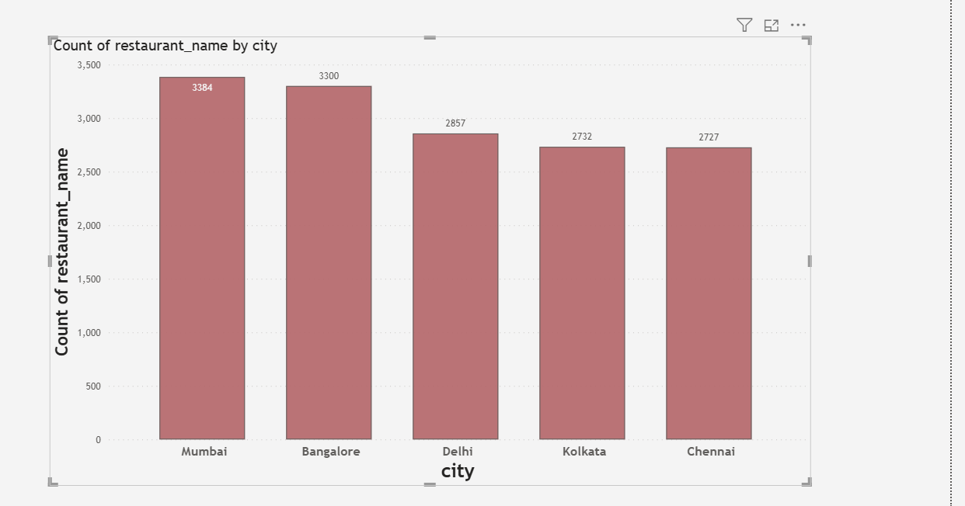
Number of restaurants in each city: Here we can see that the highest number of restaurants are in Mumbai i.e 3384.

Slide 4
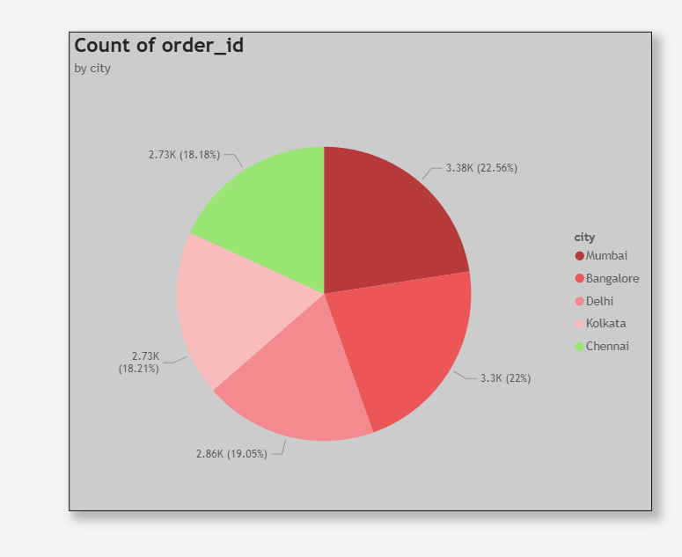
No. Of Orders In Each City:

Slide 5
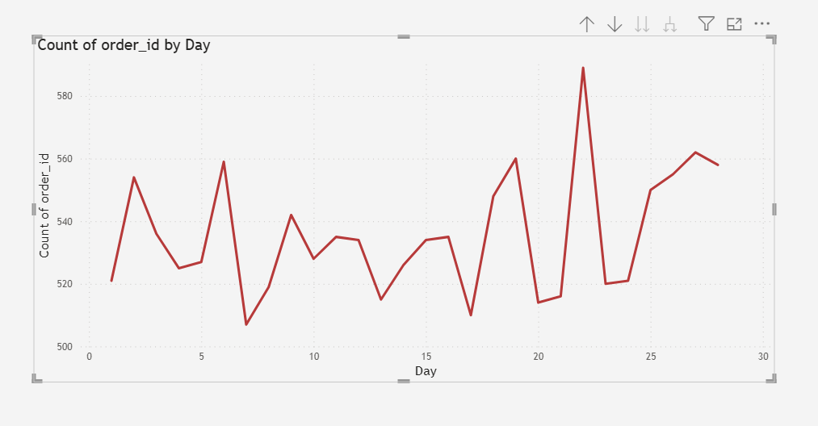
Orders Trend On Days: Here we see that between days 20 and 25, the highest no. Orders are placed.

Slide 6
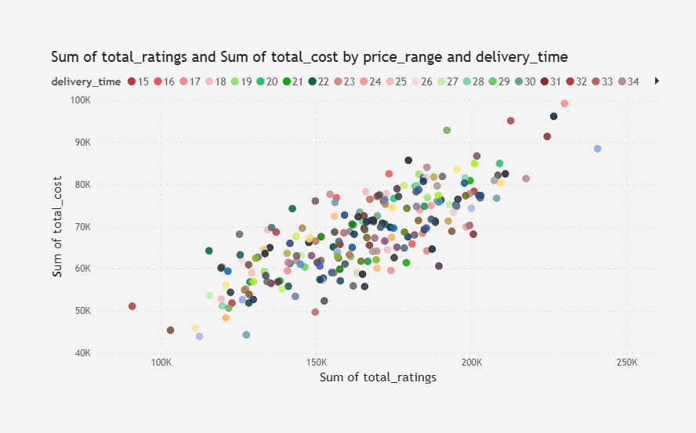
The factors like ratings, price range, delivery time and total cost are displayed by A scatter plot:

Slide 7
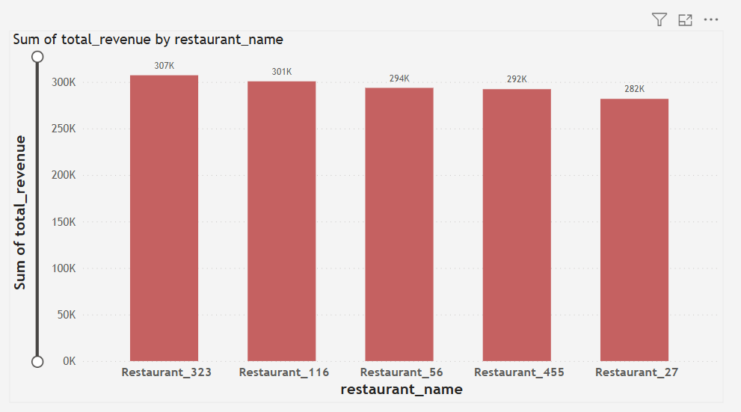
Top 5 Restaurants: Top 5 restaurants identified by total revenue generated by each restaurant.

Slide 8
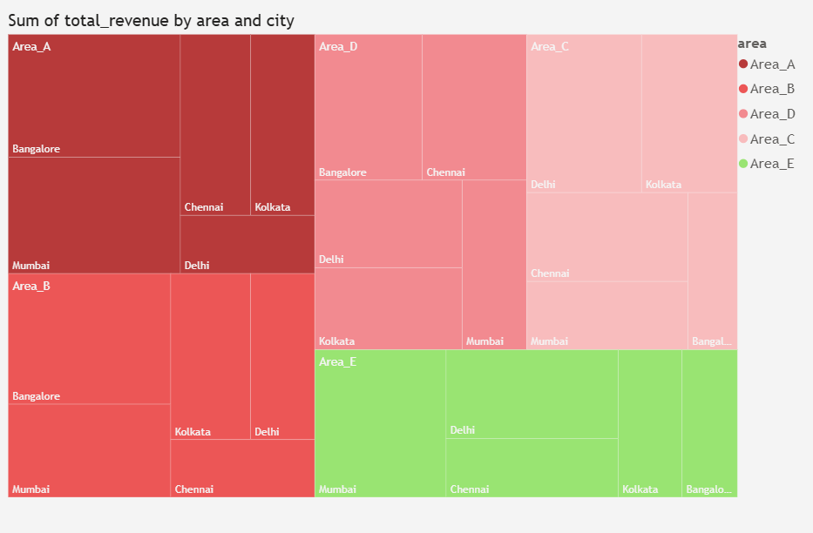
Total revenue generated by each area and city:

Slide 9
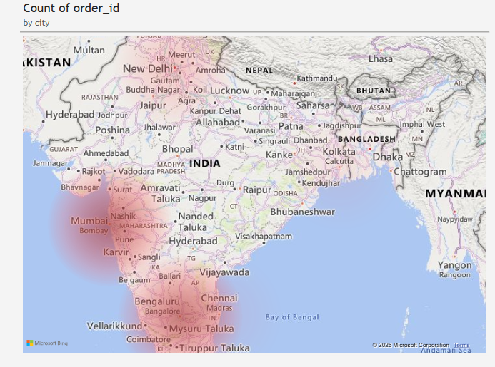
No. of orders in each cities:

Slide 10
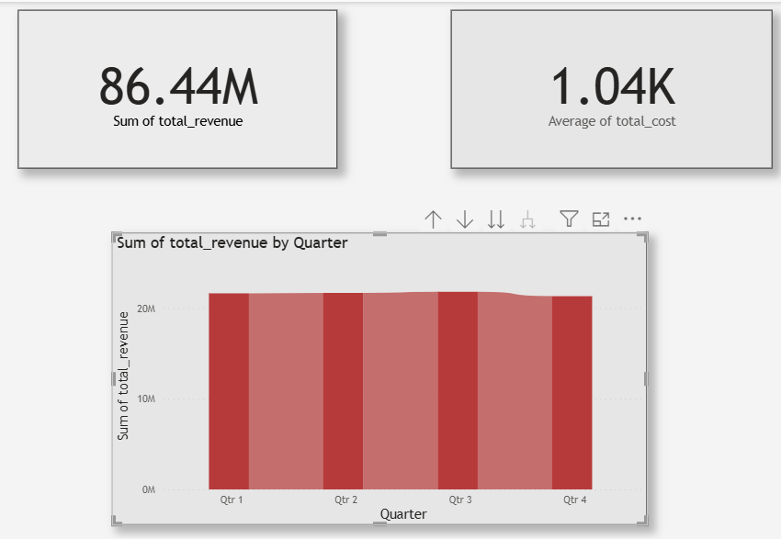
Total Cost and Total revenue generated for the period, and Quarterly trend:

Slide 11
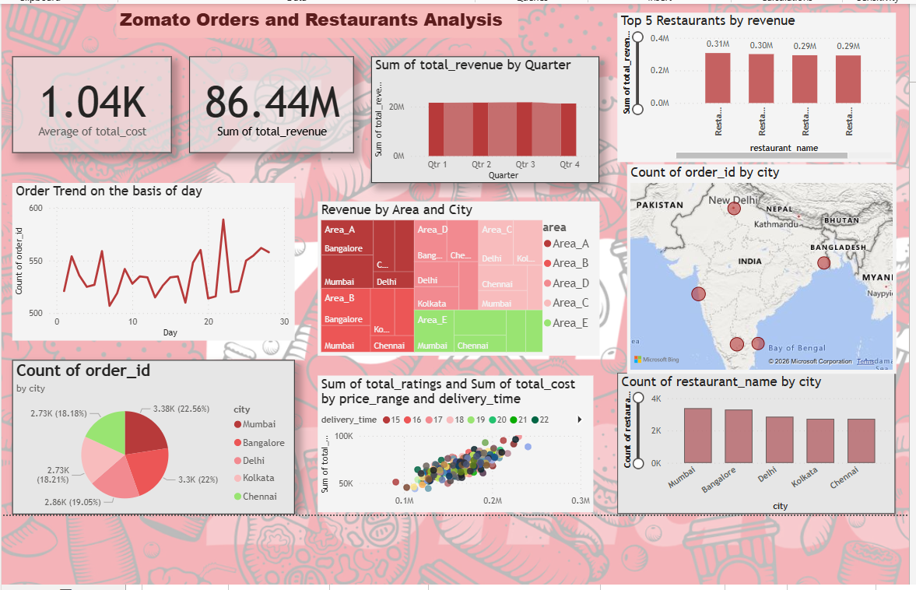

Slide 12
Dashboard
This Dashboard represents,
Total Cost for the period, total revenue generated for the period.
Quarterly revenue comparison.
The Bar chart indicates the Top 5 restaurants that generate higher revenue.
There is a trend analysis on days displayed through a line chart.
Here is the Tree map that shows the areas of the city that generate higher revenue.
Again, there is a map that represents the number of restaurants each city has, and which city has the highest no. orders.
A pie chart represents no. of orders in each City.
This scatter plot displays how various factors like ratings, price range, total cost and delivery time affect the no. of orders customer palaces.

Slide 13
Thank You!

